Slide 1
Association for Applied Sport Psychology
Proactive Peer Undergraduate Mentoring Program

Slide 2
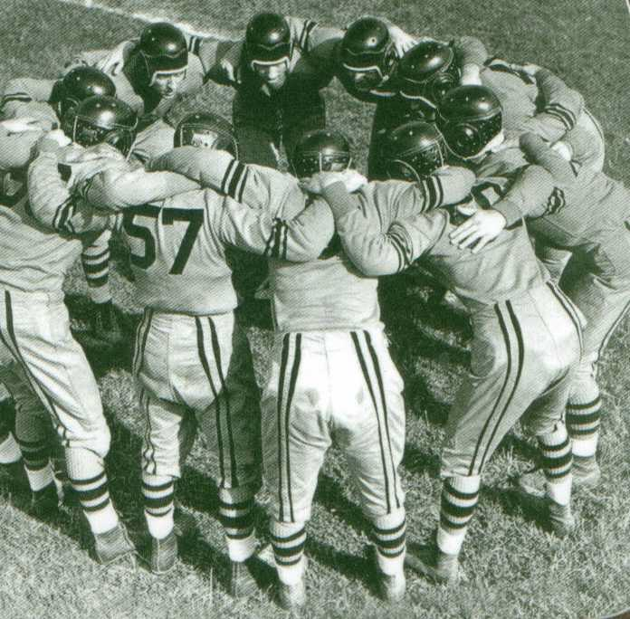
GAME PLAN
Background: What is applied sport, exercise, and performance psychology?
Who is a Sport Psychology Consultant and what do they do?
How your education can bring you into the field.
Getting involved!
Notes:
Kick things off with asking the class/group/audience how many of them have heard of sport psychology? Have they heard about “the mental game” in popular media? How about the term “mental toughness” thrown around on espn?

Slide 3
AASP
Premier global sport and exercise psychology organization
Promotes the ethical practice, science and advocacy of the psychology of sport, exercise and health
Provides certification to qualified professionals who practice sport, performance, exercise, and health psychology

Slide 4
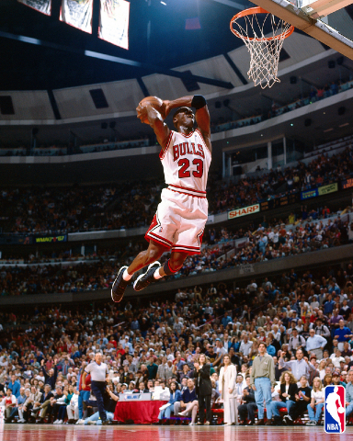
Performance Enhancement
Applying and teaching psychological skills that can both improve and eliminate barriers to optimal performance.
Psychological skills:
Imagery
Goal setting/Self-monitoring
Self-talk
Anxiety/Stress management
Attentional focus
Relaxation
Team Building/Cohesion
https://www.youtube.com/watch?v=1xWSJSgfGb8
Notes:
Ask if there are any student-athletes/sport participants/exercisers in the group- depending on the sport, use an example of one of the skills in their setting. Youtube video is of Ken Ravizza talking about the mental side of baseball.

Slide 5
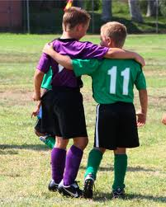
Social Psychology
Addresses research, theory, and interventions focusing upon individual and group processes in sport and exercise settings
Topics of Interest:
Disability in Sport & Exercise
Youth Sports
Peer Relationships
Sport Fandom

Slide 6
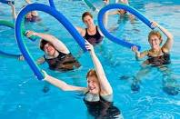
Health & Exercise Psychology
The interaction between our psychological and physical well-being, motivation towards positive health behaviors, combating the obesity epidemic.
Topics of Interest:
Exercise Adherence
Injury and Rehabilitation
Stress and Coping
Psychological Benefits of Exercise

Slide 7
CC-AASP
Certified Consultants of the Association for Applied Sport Psychology are members with a masters or doctorate degree who have completed training and coursework.
Throughout graduate training, students work with teams (team building), individuals (consultation), exercise participants (health behavior counselor)... To name a few.
Notes:
Different from the term “Sport Psychologist” because –ist implies licensure as a psychologist.

Slide 8
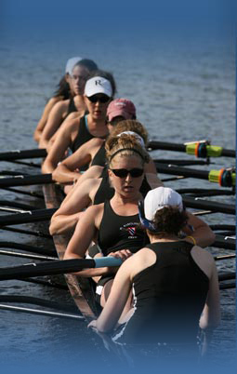
A CC-AASP May Work With....
Professional and/or amateur athletes/teams
College athletes/teams
Recreational and/or competitive athletes/teams
Youth athletes/teams
Exercise participants
Military personnel
Performers such as dancers and musicians

Slide 9
Educational Paths
Most professionals in AASP have entered through the psychology or kinesiology/sport sciences route. Ideal to take coursework in both.
Masters in Sport and Exercise Psychology
Doctorate in Kinesiology, Counseling Psychology, or Clinical Psychology
Directory of Applied Programs in Sport and Exercise Psychology 10th Edition (Sachs, Burke, & Schweighardt)
Notes:
Talk a bit more about the specific career options, how you can become a CC-AASP with a masters + extra hours, to attain faculty position, do need a phd, costs/benefits of either journey. Talk about your journey, where you plan to go, how your educational background influenced you- traditional/non traditional avenues.

Slide 10
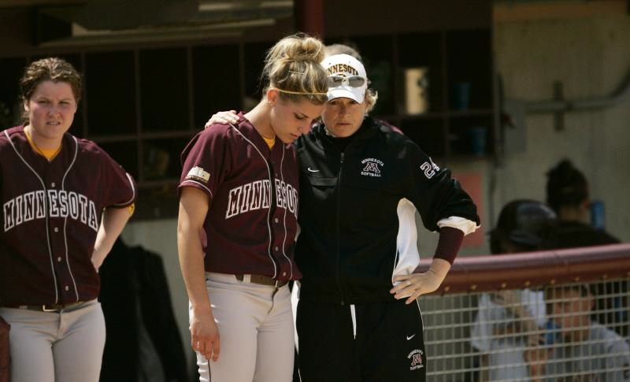
Getting Experience
Coaching- any level
Psychology research labs
Exercise physiology research labs
Personal training/group exercise
Attending sport psychology and related conferences and workshops-AASP, APA, AAHPERD
Notes:
Limited applied internships within sport and exercise psychology specifically...

Slide 11
Get Involved NOW!

Slide 12
Getting Involved
Email me! (PPUMP mentor information here)
Visit appliedsportpsych.org
Check out a regional sport psychology conference
Become a member of AASP
Attend the annual AASP conference!

Slide 13
AASP Membership Options
Professional Member: Persons with a graduate degree from an accredited institution in a field related to sport psychology
Student Member: Persons enrolled in an undergraduate or graduate program related to sport psychology in an accredited institution
Affiliate Member: Persons with an interest in sport psychology
To find more information and join AASP visit: http://www.appliedsportpsych.org/membership
Notes:
Go over some benefits for students in particular...

Slide 14
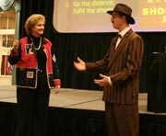
AASP Conferences
Annual Conferences
Promote the science and practice of sport, exercise, and health psychology
Present the latest research in the field
Update attendees on current
psychological services
Regional (student led) conferences can also be found in your area.
Hosts: Temple University, Georgia Southern University, University of Denver, Hope College
Notes:
Include regional conferences that are held every year... i.e. NASP at Temple University, MSEPS at Michigan State... Other regions (university rotating)

Slide 15
New Orleans, LA 2013
October 2 – 5, 2013
Hilton New Orleans Riverside
28th Annual Conference
Student discount available!
One day or full registration
Check out www.appliedsportpsych.com
or @SportPsyAASP

Slide 16
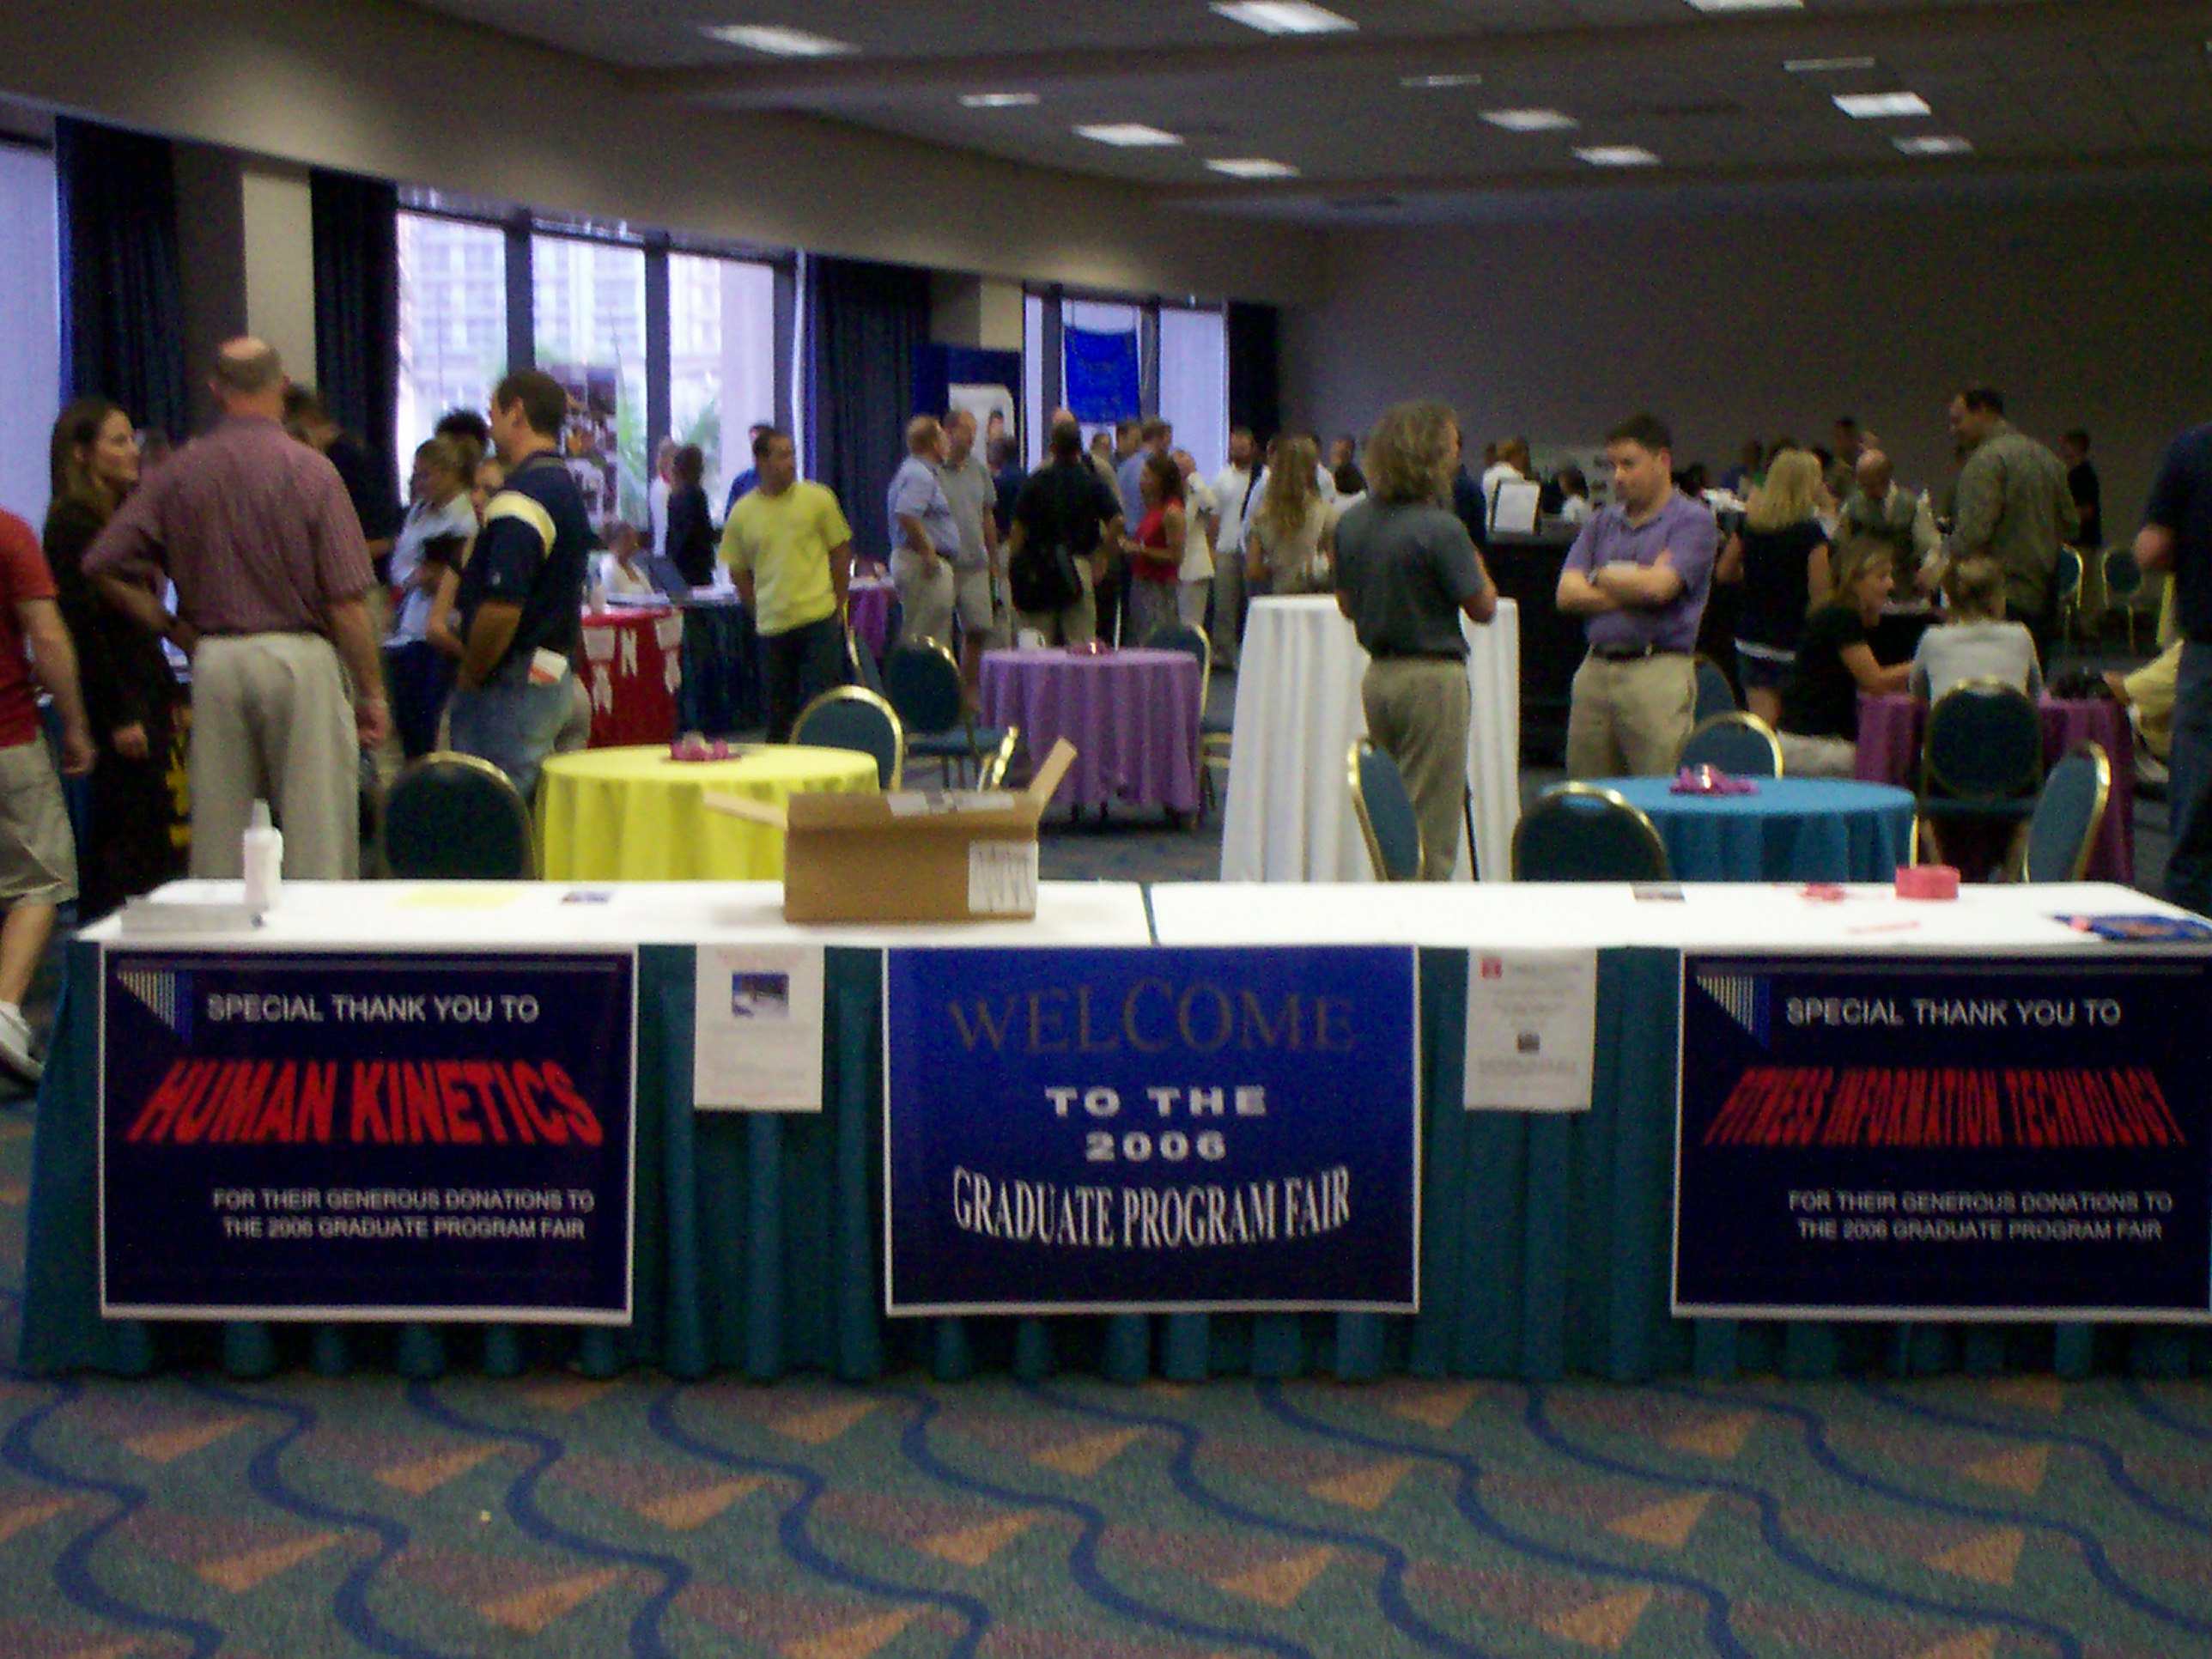
Graduate Program Fair
Meet current faculty and students from graduate programs around the world in a relaxed social environment
Obtain information concerning application procedures, degree requirements, and research opportunities from programs that interest you
Help make the decision of which programs you will apply to a little easier!

Slide 17
What is PPUMP?
A group of sport and exercise psychology graduate students who act as mentors for peers and prospective students
How can mentors help you?
Provide you with more information about the field of sport and exercise psychology
Help you, as undergraduate students, search for graduate programs that best fit their needs
Provide access to a student network to allow you to find and collaborate with students who have similar research and applied interests

Slide 18
Connect with Graduate Students and Graduate Programs

Slide 19
Do you want help finding a PPUMP mentor?
My contact info……
PPUMP Initiative Directors:
Anna-Marie Jaeschke amc.jaeschke@gmail.com
Chelsea Pierotti Chelsea.Pierotti@unco.edu

Slide 20
Thank you! Questions??

