Slide 1
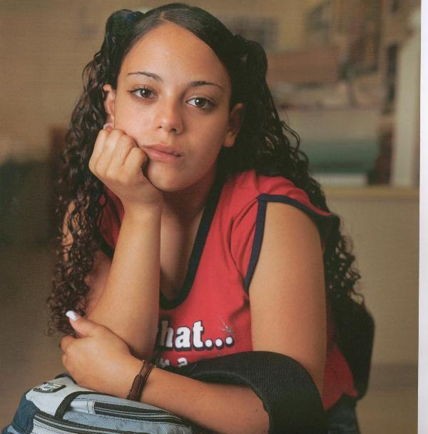
Positive Development in Sports
The Active Minds of Youth
Reed Larson
with S. Cole Perry
University of Illinois, Urbana/Champaign
Research articles available at:
www.youthdev.illinois.edu
Supported by the
William T. Grant Foundation
Notes:
Expertise: The more you learn the less you know
Researchers, Academics: method of doubt, asking questions
At best, my expertise means I’m ignorant about more complex things
There is different kinds of expertise:
How may of you have worked directly with youth for 3 years or more?
8 years or more?
20 years as more?
You have an expertise that I don’t have.
But doubt, knowing what is not true, is really important

Slide 2
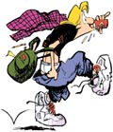

Slide 3
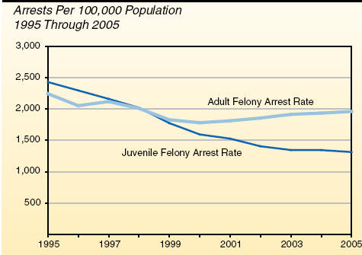

Slide 5
Under the right conditions, adolescents have enormous potentials for learning and development

Slide 6
Teens gain powerful new capacities

Slide 7
The developmental challenges of coming of age are complicated!

Slide 10
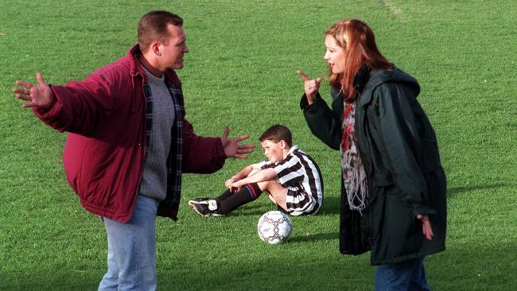
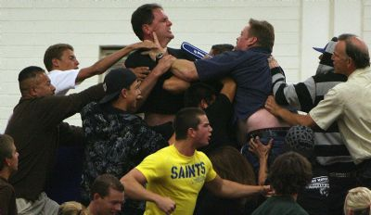
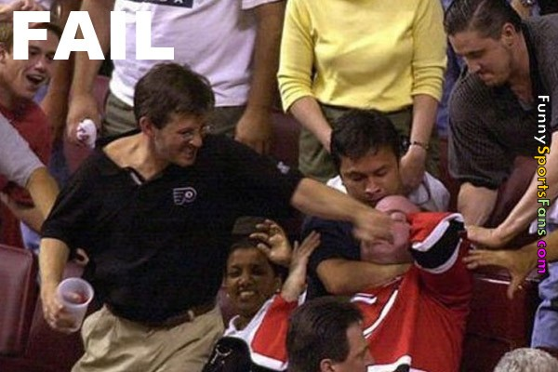

Slide 11
What’s fake and what’s real?
What matters, what doesn’t?
Who do I pay attention to?
Classical coming-of-age challenges:
Balancing self with others: I vs. We
Free will vs. determinism
The mind-body problem

Slide 12
I. New Thinking Capacities
II. Sports and Youth Programs as Contexts of Development
III. Emotional Development
IV. Development of Teamwork Skills
V. Conclusion: Facilitating Positive Development

Slide 13
I. New Thinking Capacities

Slide 14
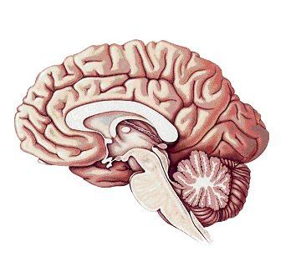

Slide 15
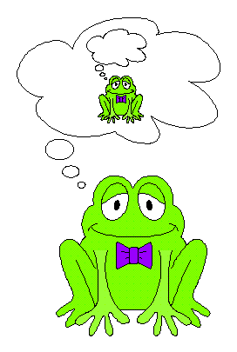
Meta- Cognition

Slide 16
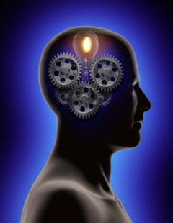
ADOLESCENTS' NEW THINKING SKILLS
Abstract Reasoning
B. Systems Thinking
C. Multiple Systems
D. Executive Skills

Slide 17
Definition: Abstract
Concepts that can not be directly perceived with the senses;
are inferred or posited

Slide 18
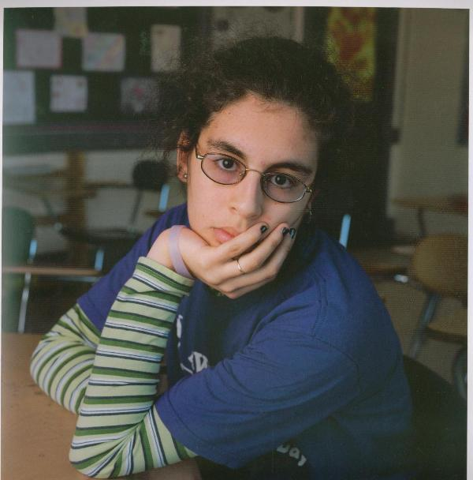
Examples of Abstract Concepts
Physics: Density, Mass, Acceleration
Social: Reciprocity, Society
Psychological: Emotions, Motivation

Slide 19
ADOLESCENTS' NEW THINKING SKILLS
Abstract Reasoning
B. Systems Thinking
C. Multiple Systems
D. Executive Skills

Slide 20
Definition: System
A group of interacting, interrelated, or interdependent elements forming a complex whole.

Slide 21
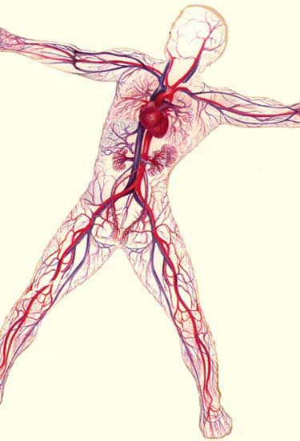
Notes:
I chose the circulatory system because I found a simple diagram with arrows that showed a system relevant for athletes

Slide 22
Team Cohesion

Slide 23
Perspective Taking
(from Sarah J. Blakemore)

Slide 25
ADOLESCENTS' NEW THINKING SKILLS
Abstract Reasoning
B. Systems Thinking
C. Multiple Systems
D. Executive Skills

Slide 26
Youth-Coach-Parent Triangle
Youth
Coach
Parents

Slide 27
Types of Multiple Systems
Parallel Systems Embedded Systems Dynamic Systems

Slide 28
Balancing Systems

Slide 30
ADOLESCENTS' NEW THINKING SKILLS
Abstract Reasoning
B. Systems Thinking
C. Multiple Systems
D. Executive Skills

Slide 31
Herd Ball

Slide 32
Executive Thinking

Slide 33
Planning

Slide 34
Potentials – Not Inevitabilities

Slide 35
Common Teen Driving Errors (National Research Council, 2007)
Not searching ahead before left turns
Not adjusting speed to traffic and road conditions
Driving while impaired by sleepiness or alcohol

Slide 36
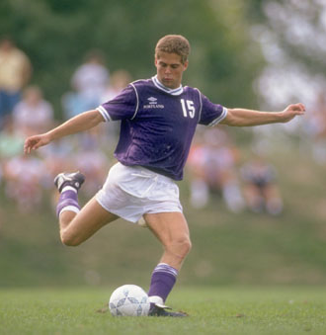
II. Sports and Youth Programs as Contexts of Development

Slide 37
During Class
Challenge Motivation

Slide 38
Free Time With Friends
Challenge Motivation

Slide 39
Non-Sport Youth Programs
Challenge Motivation

Slide 40
Sports
Challenge Motivation

Slide 41
“Engagement with Challenges”

Slide 42
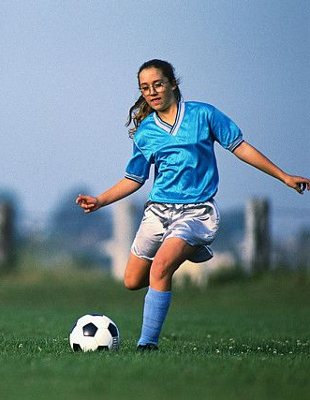
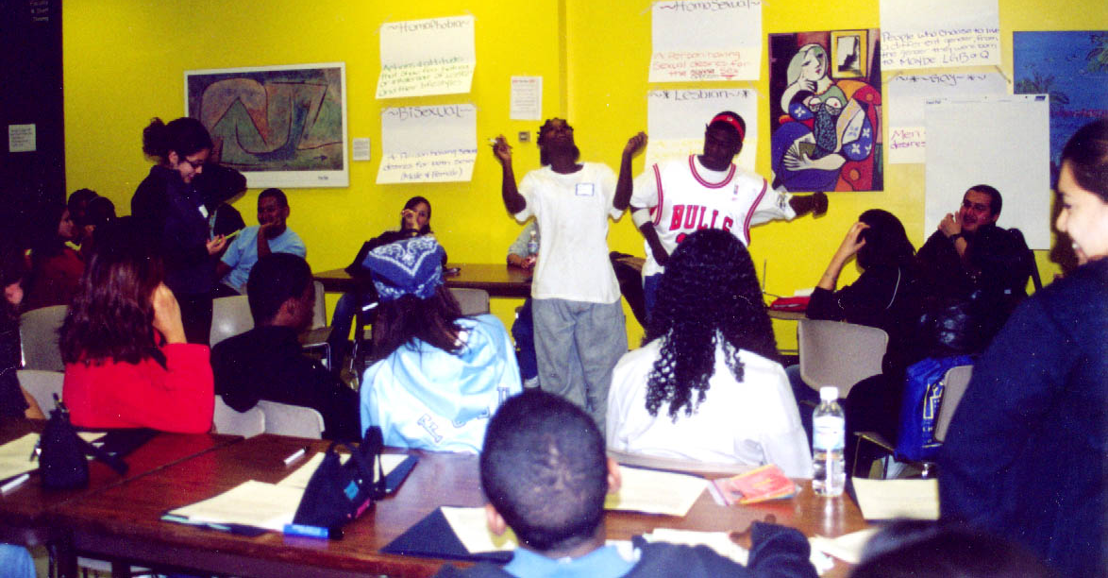
Youth Programs as a “Natural Laboratory”
for Positive Development

Slide 43
Our Research Goal
Understand process of conscious positive development in programs from the accounts of youth
(and program leaders)
Notes:
Understanding youth’s developmental experience in programs from accounts of:
Youth
Program Leaders
Kate and will be talking a lot about a study we did called TYDE

Slide 44
TYDE Study
11 urban & rural high quality arts, tech, leadership programs for high-school-aged youth
Studied longitudinally over 2-9 months
Notes:
High school aged
Leadership, activism
Arts and technology
Work on Projects
-- Projects at important vehicle for development at this age period

Slide 45
The Data Set
712 total interviews with 108 youth (36 White; 32 African American; 32 Latino; low income to middle class)

Slide 46
Grounded Theory on Youth’s Development of:
Motivation
Emotional Skills
Teamwork
Strategic Thinking
Responsibility
Social Capital
Autonomy from Parents
Research articles available at:
www.youthdev.illinois.edu
Notes:
Our findings: The processes through which youth developed these assets
Published over 20 articles.
On Website
Across topics, a central finding…

Slide 47
Focus of Analysis for Each Developmental Domain
Challenges Faced
What Learned
How it was Learned

Slide 48
III. Emotional Development in Youth Programs and Sports
(Child Development, 2007)

Slide 49
Emotions as Challenges
Point → → Point
A B

Slide 50
Emotions’ Functions
Arouse and direct energy and attention in the service of important goals
2. Promote and regulate social interactions
3. Provide useful information and assist with healthy decision making – though they can also mislead

Slide 51
Emotions Are Challenging Puzzles
“a riddle wrapped in a mystery inside an enigma”
(Ochsner & Gross, 2007)

Slide 52
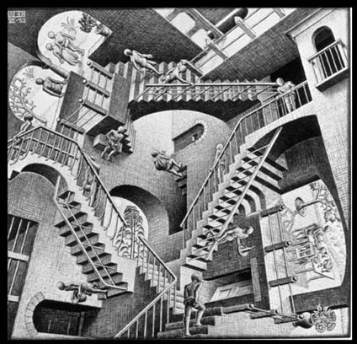
Puzzles
Are emotions the real me? Or biological processes?

Slide 53
A. Emotional Challenges in Youth Programs
“My nerves got to me, dry mouth”
“When people got angry, other people got angry.”
“We did really badly on a dance; we did horribly”

Slide 54
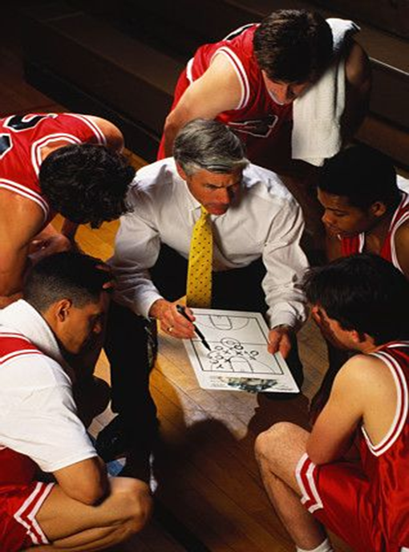
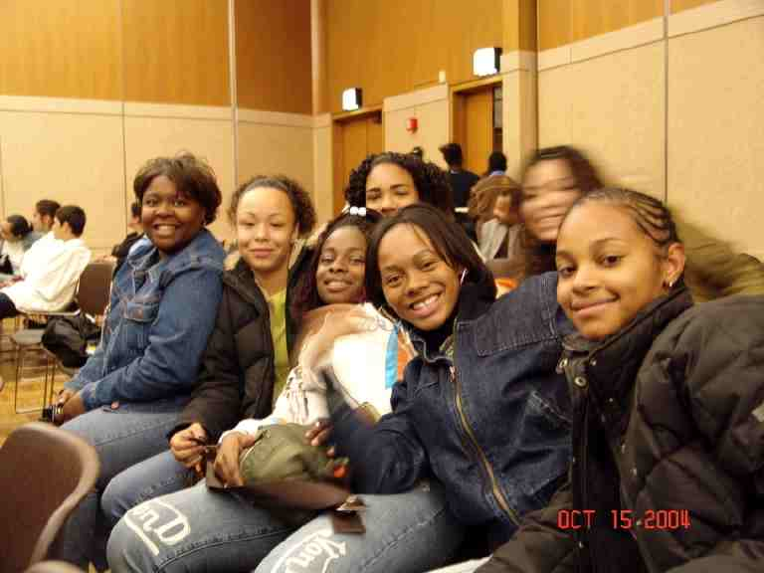
Sports (&Youth Programs): “a rich emotional environment” (Scanlan et al. 2005)

Slide 55
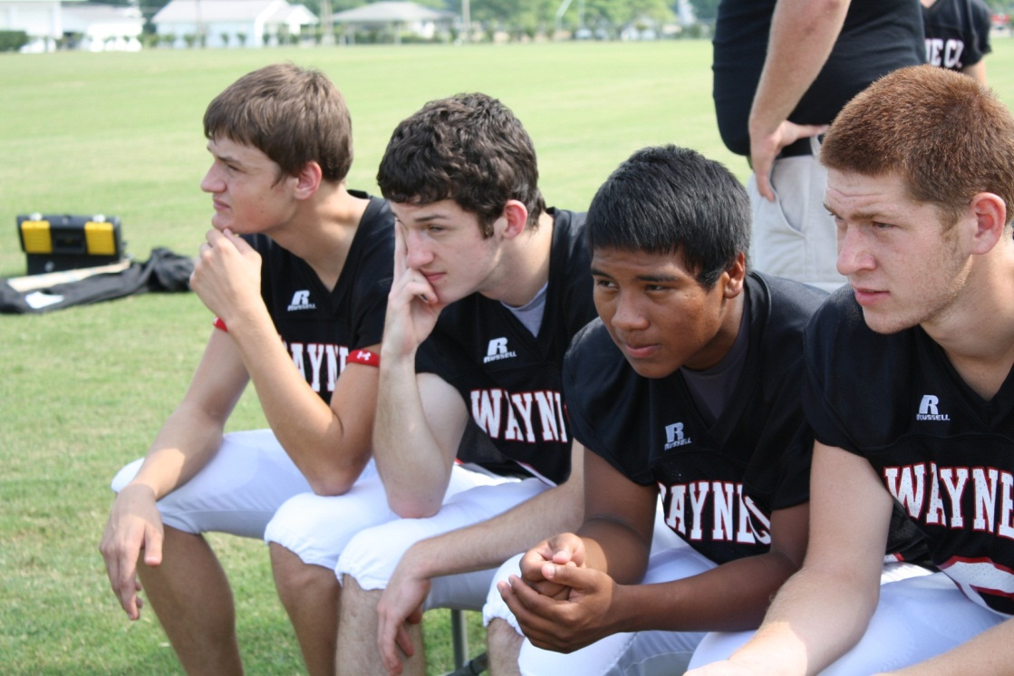
B. What Youth Learned?

Slide 56
1. Knowledge of Emotions as Dynamic Processes
a) Causes/antecedents of emotions
-- personalities
-- physical states (like tiredness)
-- types of situations
b) Effects of emotions
-- anger is contagious
-- exhilaration “wipes away fear and doubt.”

Slide 57
2. Management of Negative Emotions
Limiting Expression to Others
Perseverance
Social Support
Reframing
Problem focused

Slide 58
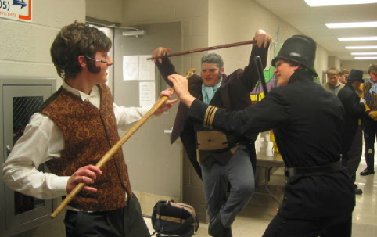
3. Learning to Use Emotions
‘If I can’t figure something out and I am worried about it, I just like plan harder. Something just clicks, “Try harder, don’t give up.”’

Slide 59
“You learn how to take them in and let them go in through one [end] and just out the other… I guess, we just took them in and like understood them.” Consuela, Art First

Slide 60
What Youth Learned
Knowledge of emotional episodes as predictable processes.
Executive strategies for shaping episodes in ways that served the goals of the project.

Slide 61
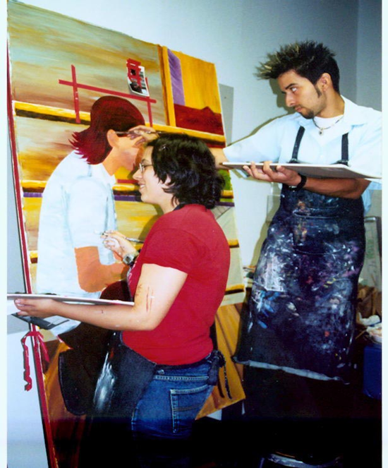
C. How Youth Learned?

Slide 62
Producers of Own Development
“I saw that…”
“I discovered that…”
“I’ve been working on that”
“we realized that”

Slide 63
Observation and Analysis
Analyze Situations
Compared Emotions across situations and people
Thought Experiments about hypothetical courses of action

Slide 64
D. Emotional Development Conclusions

Slide 65
Survey Findings (N=2,000)
“I learned that my emotions affect how I perform”
56% of teens in sports
41% of teens in other programs.
(Larson, Hanson & Moneta, 2007)

Slide 66
“It’s funny ‘cause once you analyze why you’re mad or happy or frustrated then you listen to yourself, it just seems so surreal “Like, oh my god!” And it’s good.”
Consuela, Art First

Slide 67
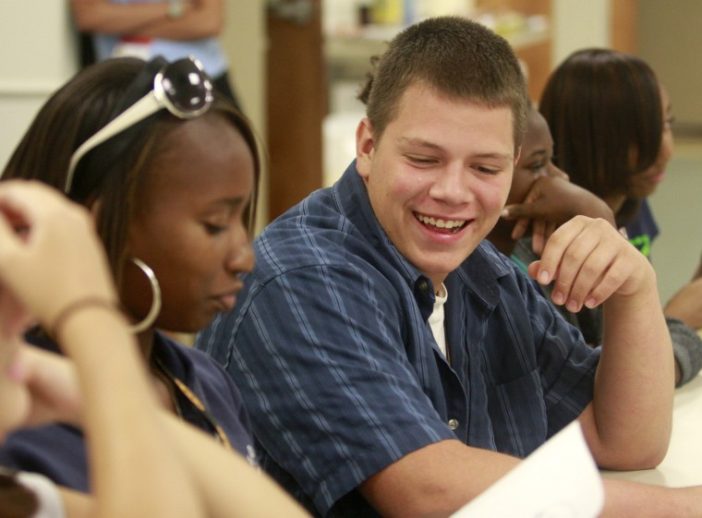
IV. Development of Teamwork (Collaboration) Skills in Youth Programs & Sports

Slide 68
Skills for collaboration and teamwork are critical for most jobs in the 21st Century (National Research Council, 2012, Partnership for 21st Century Skills, 2011; Parker, Ninomiya, & Cogan, 1999; SCANS, 1991).
National Panels:

Slide 69
A. The Challenges and Puzzles of Teamwork

Slide 70
1. “You want to do what?”
The Problem of Other Minds

Slide 71
2. Not being a jerk
Wanting to be perceived as nice/good/cool

Slide 72
“If you bring work and friendship together there will be so much tension that it is not going to work out either way.” Jackie

Slide 73
3. “They’re driving me nuts, aahh!”
Other’s obnoxious behavior

Slide 74
Alex’s tennis partner
“I could never understand why he was always getting so angry; it seemed so obvious to me that he played worse when he got mad.
When I tried to calm him down; he just got more angry. So there I was, wanting us to do better and I thought he needed to be calm, but I couldn’t think of anything to do to resolve the situation”

Slide 75
B. What Youth Learned?

Slide 76
1. “You want to do what?”
The Problem of Other Minds

Slide 77
What Phillip Learned
“I've actually figured out that:
1. if you like talk to 'em and be nice to 'em
2. you actually figure out their background and stuff like that
3. so you like learn how to actually work with them the way that they're used to working
4. instead of making them work your own thing”

Slide 78
2. Not being a jerk
Wanting to be perceived as nice/good/cool

Slide 79
Media Masters
The good thing of working in the group is that they give their opinion about thing we’re working on. It helps me get more ideas. (Joaquin)
Working with other people you get more chances of finding other ways to express what you’re doing. (Rogilio)

Slide 80
3. “They’re driving me nuts, aahh!”
Other’s obnoxious behavior

Slide 81
“You can’t let other people affect you, and make you negative; you just gotta be you; sometimes you’ve just gotta hold your breath and do it.”
Hector
“Sometimes you gotta get your foot up their rear and drag em in.”
Jamie

Slide 82
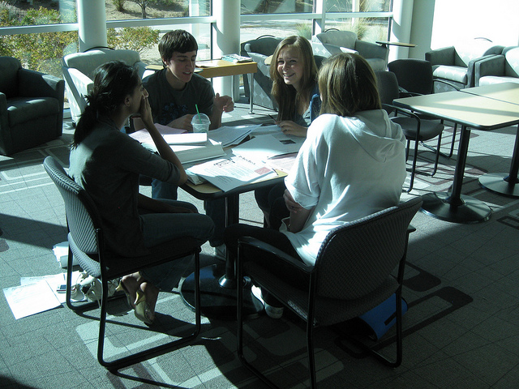
C. How Youth Learned?

Slide 83
Youth as active producers of own development

Slide 84
Abstract Modeling
"You see all of the friends that came here together. You see how well they work together … if you watch them you're like, … ‘that looks cool. I'll try that.’
... like see from other people's faults or your faults. Just the mistakes that are made and how to improve it next time”
Laura, summer camp

Slide 85
‘You get used to different personalities and then when you go to work, …you're like, "Oh I remember someone who is like this" and … what made it the easiest to work together.’ Marta, summer camp

Slide 86
Grounded Theory on Youth’s Development of:
Motivation
Emotional Skills
Teamwork
Strategic Thinking
Responsibility
Social Capital
Autonomy from Parents
Research articles available at:
www.youthdev.illinois.edu
Notes:
Our findings: The processes through which youth developed these assets
Published over 20 articles.
On Website
Across topics, a central finding…

Slide 87
V. Conclusion: Facilitating Positive Development

Slide 88
Good coaches translate experiences into knowledge and skills (Gilbert & Trudel).
Good leaders help youth translate experiences into knowledge and skills

Slide 89
Multiple Levels of Leaders’ Roles
Cultivating Program Culture
2. Creating Activity Structure and Schedule
3. Day-to-Day Facilitation
4. Responding when “Stuff Happens”

Slide 90
1. Cultivating Program Culture.
Safety, mutual respect and trust, belonging, and program identity
Models of motivation and action
An “emotion culture”
Youth ownership of the culture

Slide 91
2. Creating Activity Structure and Schedule
Variation in leaders vs. youth planning
All programs have an arena of youth agency
Roles for youth
Cycles of planning, executing, authentic feedback, and reflection.
Leaders have high expectations

Slide 92
3. Day-to-Day Facilitation
Emotion coaching
Teamwork coaching
Leading from behind
Encouraging, nudging and prodding

Slide 93
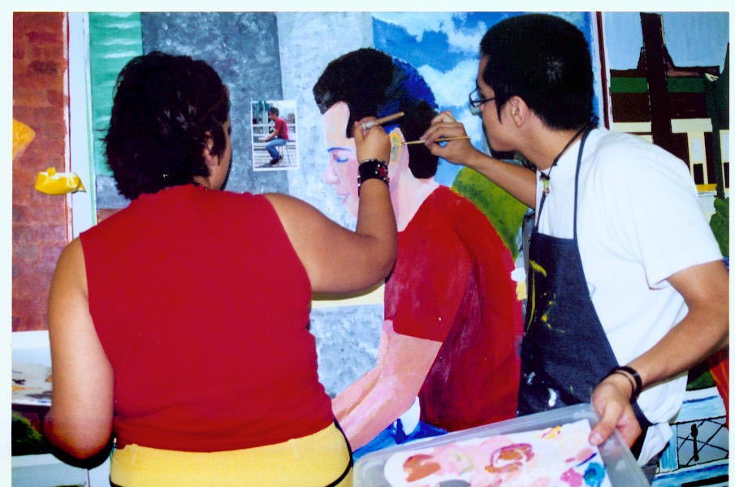
4. Responding when “Stuff Happens”
Dilemmas of Practice

Slide 94
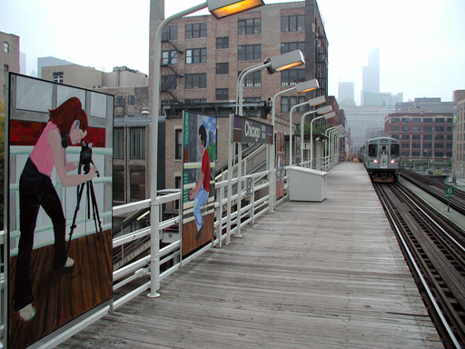
Copy of articles available at:
www.youthdev.illinois.edu

Slide 95
Features of Positive Developmental Settings (National Research Council, 2002)
Physical and Psychological Safety
Appropriate Structure
Supportive Relationships
Opportunities to Belong
Positive Social Norms
Support for Efficacy and Mattering
Opportunities for Skill Building
Integration of Family, School, and Community Efforts
Notes:
Idea: a list of what should

Slide 96
“Positive development through sport must be deliberately worked toward by coaches, parents, sports organizations and policy makers”
(Fraser-Thomas, Cote & Deakin, 2005, p. 32)

